Slide 1


Coffee and Contracts:
A Social Needs Contracting Community of Practice
The Intersection of Data Security, Compliance, and Quality Improvement: A Hub’s Journey
Abigail Morgan, President & CEO, Direction Home Akron Canton
June 11, 2024 | Noon-1:00 p.m. ET

Slide 2

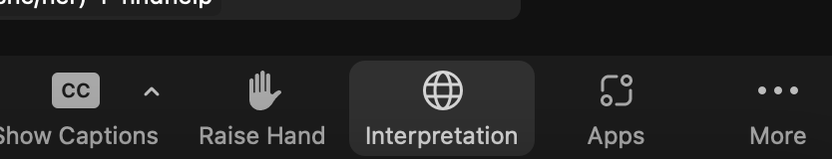
Administrative Notes
This meeting will be recorded and shared with registrants and posted on the Partnership website after the session.
This session is about learning and creating partnerships. You drive the conversation.
Please engage in the discussion on any level you prefer and are able to!
Closed captions are provided for this session, can also click “Show Captions” to display automated captions
Notes:
Before we get started, just a few quick administrative notes. First, this webinar will be recorded and shared via email with all registrants. Also, we want to hear from you! We may also be able to answer some via the chat function during the webinar. Lastly, there is an option to view closed captions for this webinar for those who would like to use that function. Please click on the “show captions” option on the menu bar to activate the closed captions.

Slide 3
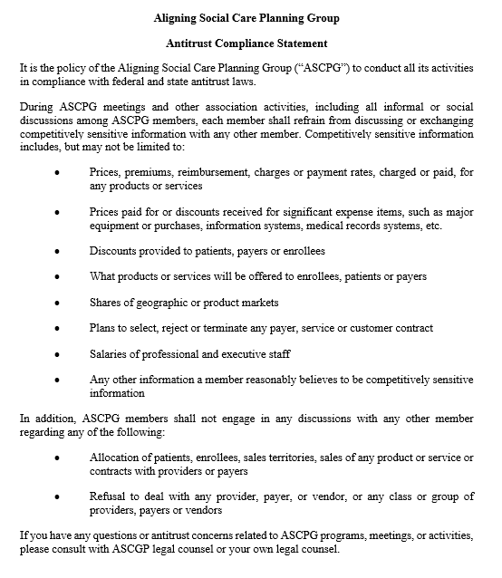
Antitrust
Statement

Slide 5

Join us on Tuesday, August 13 @ Noon ET !
Coffee and Contracts: A Social Needs Contracting Community of Practice
2nd Tuesday of each month in 2024 @ Noon ET
Attendee Limit 300
  Peer to peer learning about contracting between CBOs, CCHs, and healthcare organizations
  Engage new members to Partnership to Align Social Care
  Support new CCHs that are funded through ACL COE
  Generate new learning which can be packaged in new products (briefs, guides, blogs, webinars)
  Learn more and catch up on previous sessions at www.partnership2asc.org/coffee-and-contracts

Slide 6
Closing Survey

Slide 7
Thank You!
Get in Touch!
Abigail Morgan – amorgan@dhad.org
Partnership Contacts
Jeremiah Silguero – jsilguero@partnership2asc.org
Autumn Campbell – acampbell@partnership2asc.org

Slide 8


How to Get Involved in the Partnership…
Sign up for our email list: https://www.partnership2asc.org/sign-up/
Follow the Partnership on social media:
Reach out directly to:
  Support the Partnership
  Ask about getting involved in leadership/workgroup activities
  Share your expertise/experiences
www.linkedin.com/company/partnership-to-align-social-care
@partnership2asc

Slide 9
Discussion

Slide 10
Discussion questions/topics: Breakout Rooms
We know that it is a long journey for CBOs to develop their data security infrastructure. Let's open up the floor - would anyone like to share their own experiences in data security?
Does anyone have any questions or thoughts on data security?
As the Contracting workgroup thinks about other topics to cover in future C&C sessions and resources to generate, are there specific topics you would like us to go deeper on in the realm of data security and IT? What resources would be most helpful to you?

